Slide 1
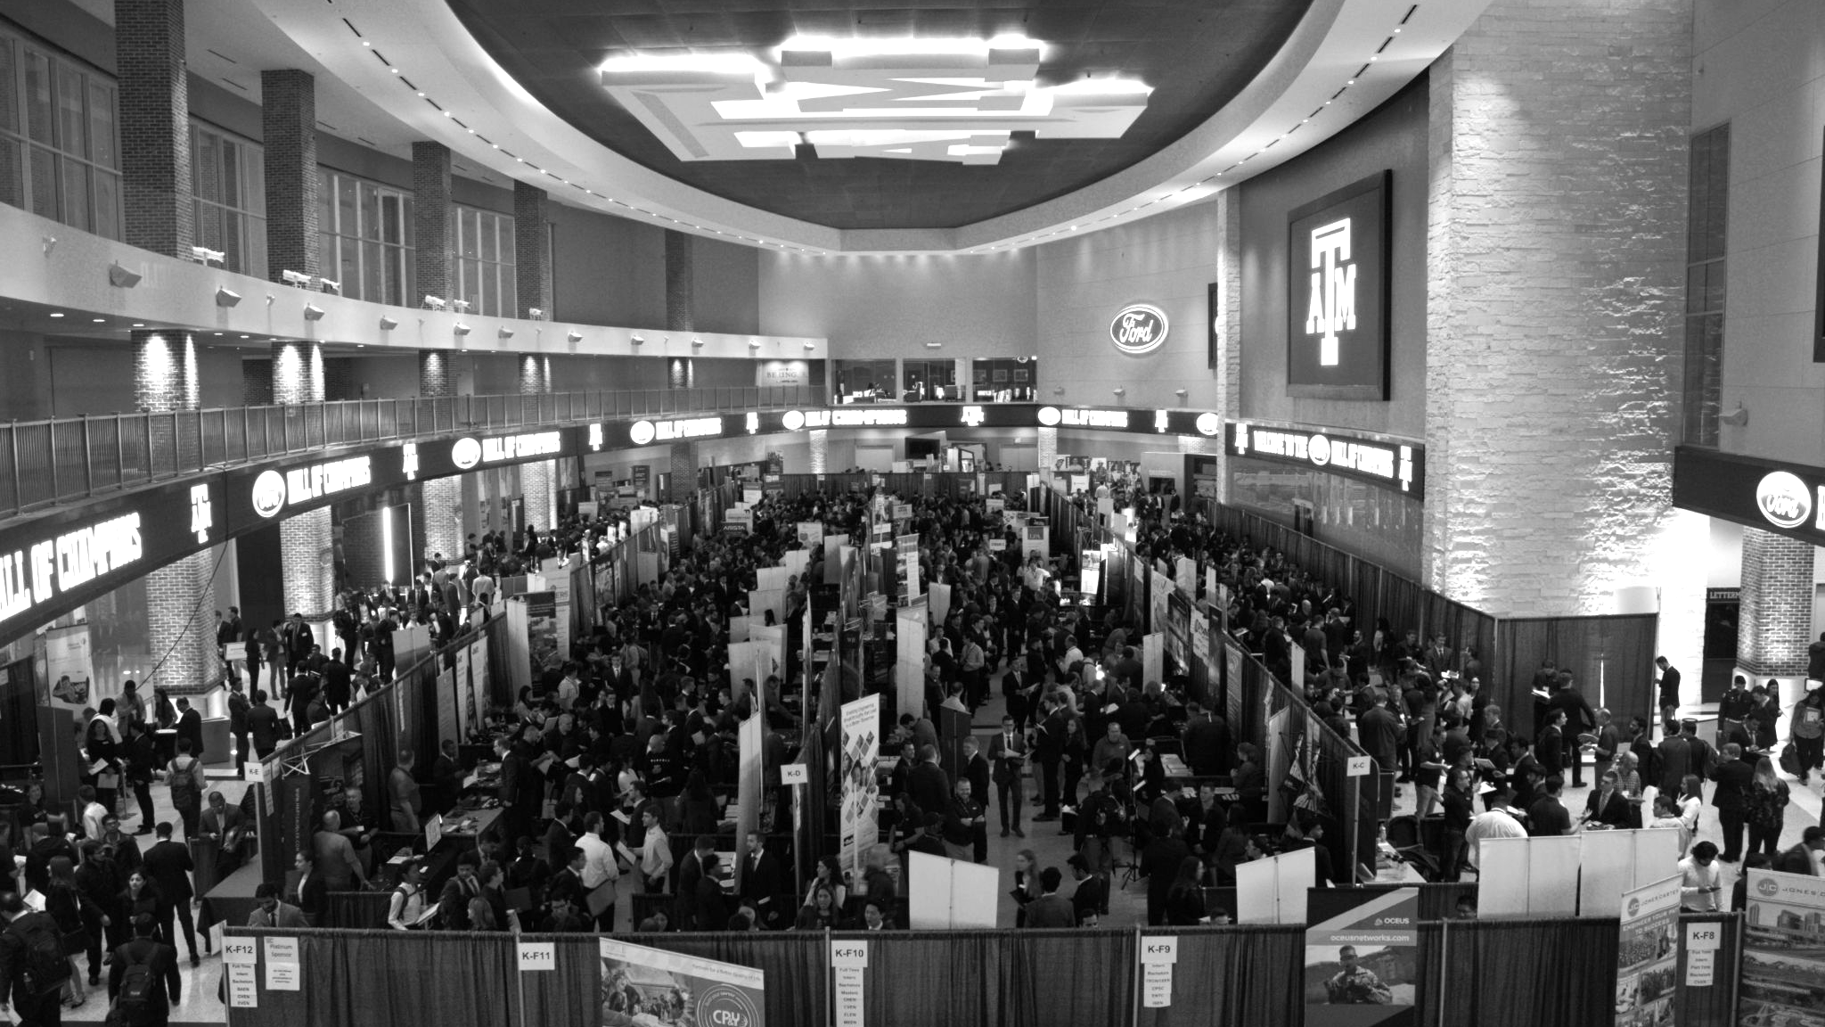

LANL Team Week 1 Project Update
1/15/2025
Izzy Baumler, Dalton Boeckmann, Morgan Gullo, Jade Waldron

Slide 2
Problem Statement/Project Motivation
There is a need for a technology that has 6 DOF and can move through its full range of motion in each degree of freedom of at least 1 Hz.

Slide 3
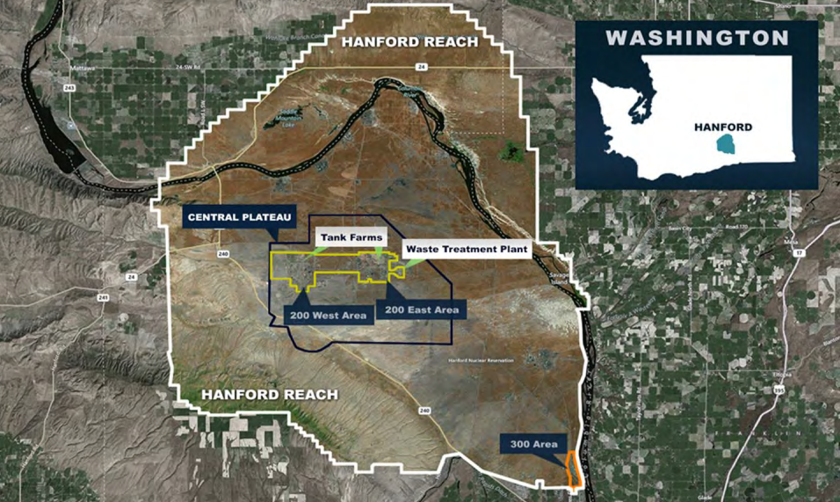
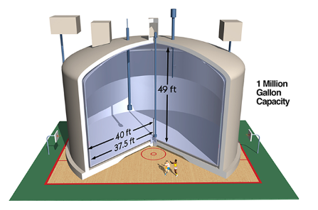
Problem
Location: Hanford Site, Washington State
Background: 45+ years of plutonium production has led to 56 million gallons of hazardous and radioactive waste stored at the Hanford Site.
Problem: Original tanks designed for 25 years; most now exceed this, with approximately 68 tanks in critical condition.
Risk: High environmental and health risks due to tank deterioration, posing a growing threat to surrounding areas.
‹#›

Slide 4
Design Requirements
The Design Requirements Table cross-references requirements with the customer needs satisfied. The table provides the importance of each metric as well as the target value.
Requirement # | Need # | Metric | Importance Score (1 to 5, 5 = most important) | Required Values | Units
1 | 7,5 | Weight of the Arm | 3 | <14 | kg
2 | 1,2,4 | Maximum Torque Output | 3 | 2-10 | Nm
3 | 2,3,8 | Positional Accuracy | 3 | 10-30 | mm
4 | 2,5 | Reach of Robotic Arm | 3 | >0.67 | m
5 | 3,5,7 | System Mass Distribution | 2 | 0.209 | kg/cm
6 | 1,2 | Max Movement Speed of the Arm | 5 | 1 | m/s
7 | 1,2,3,5 | Frequency of Motion | 5 | 1 | Hz

Slide 5
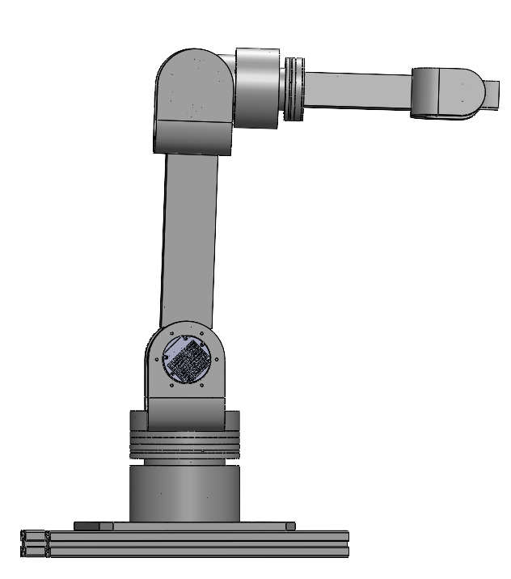
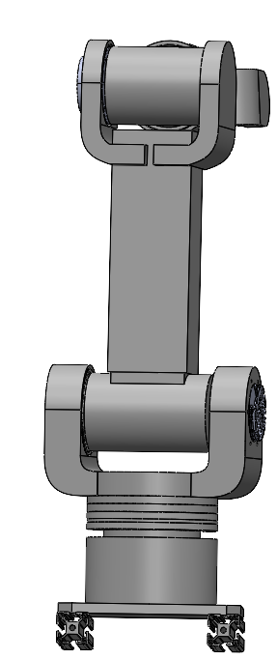
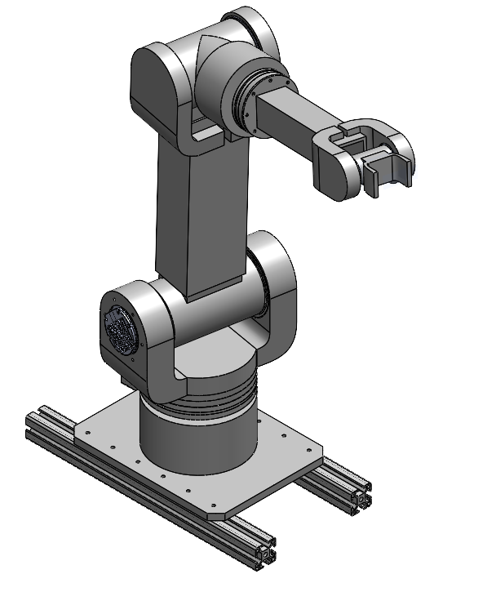
Final Design

Slide 6
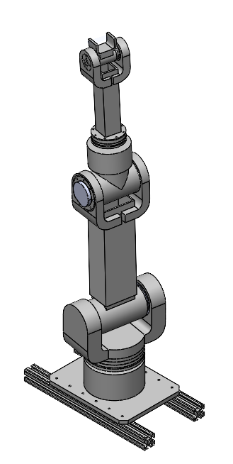
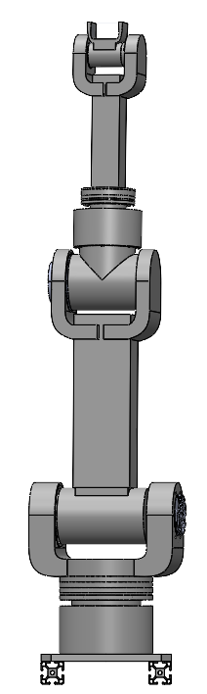
Detailed CAD - Full Upright Extension

Slide 7
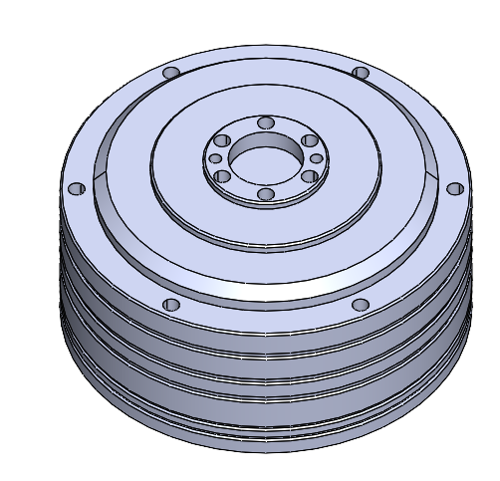
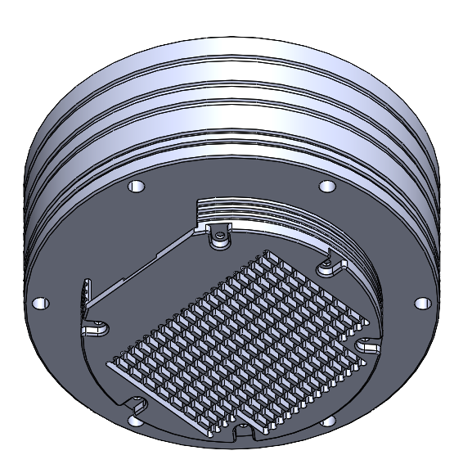
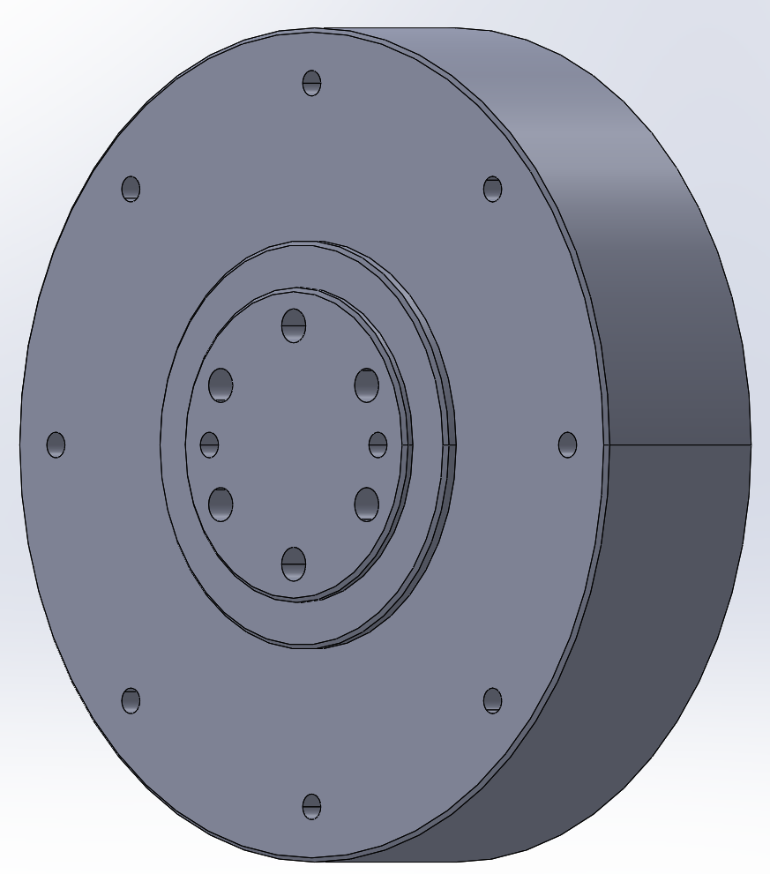
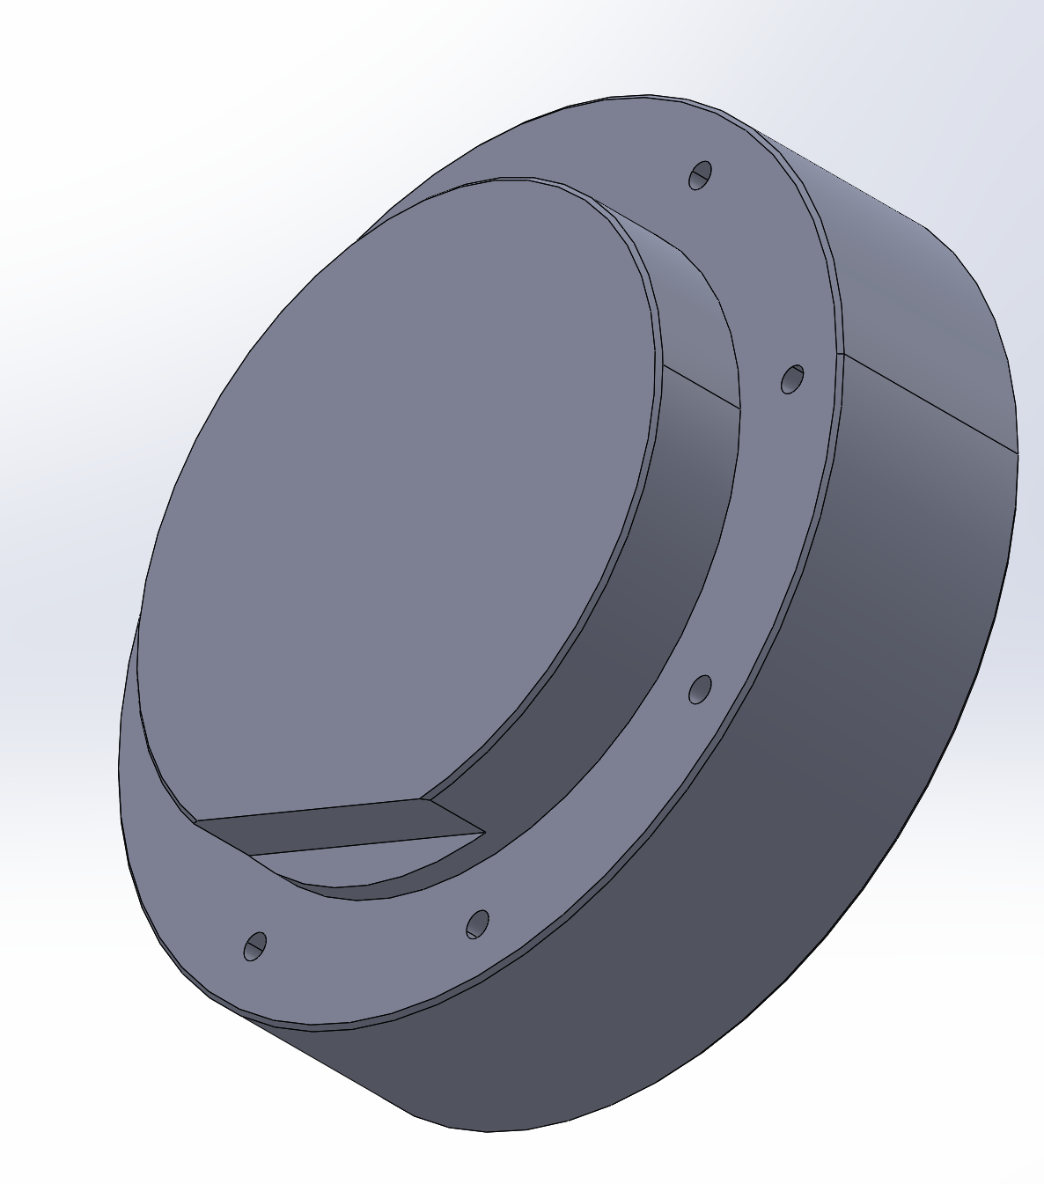
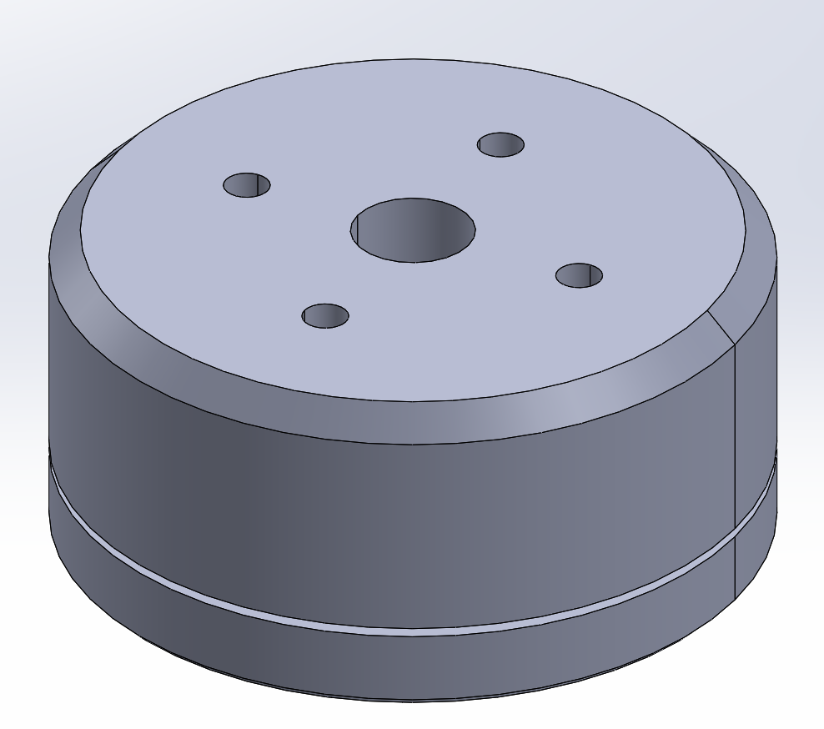
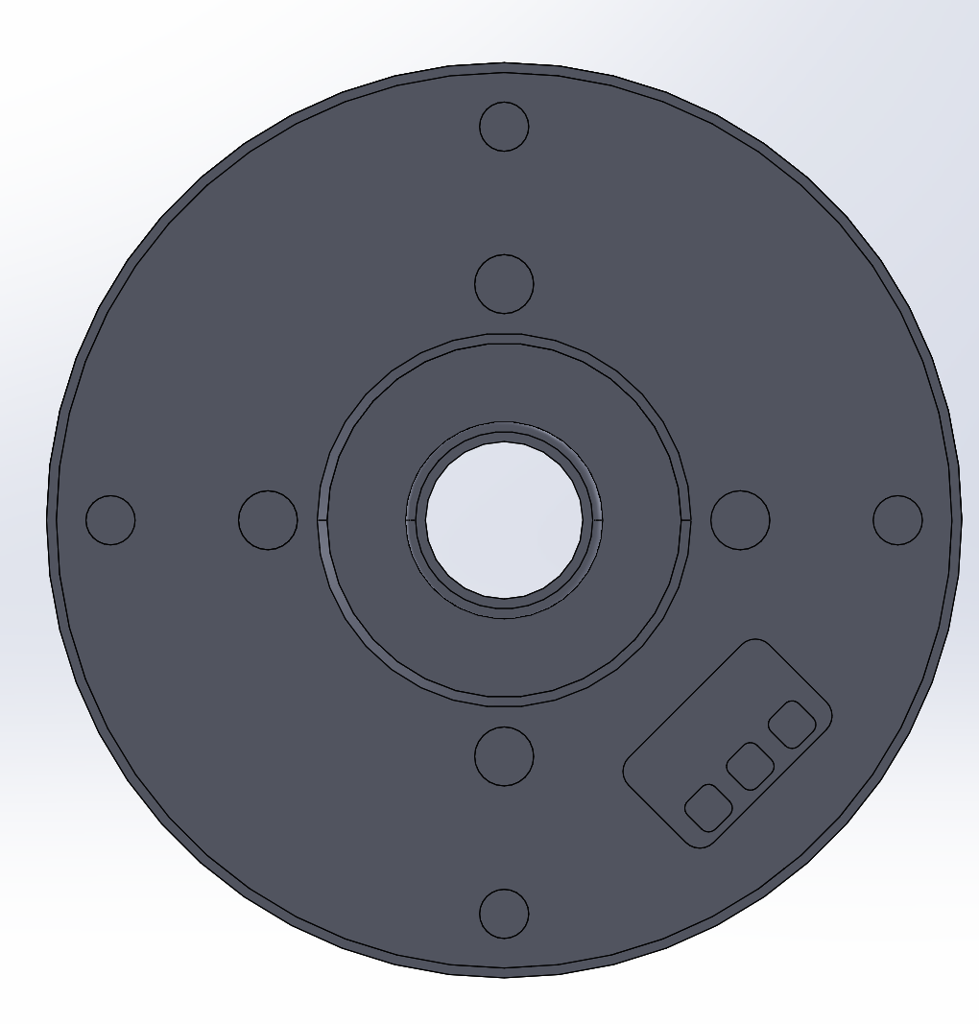
Detailed CAD - Joint Motor(s)
We selected brushless DC motors and prioritized speed
Each motor comes with an encoder and driver
Reached out to CubeMars and asked for detailed CAD models of motors

Slide 8
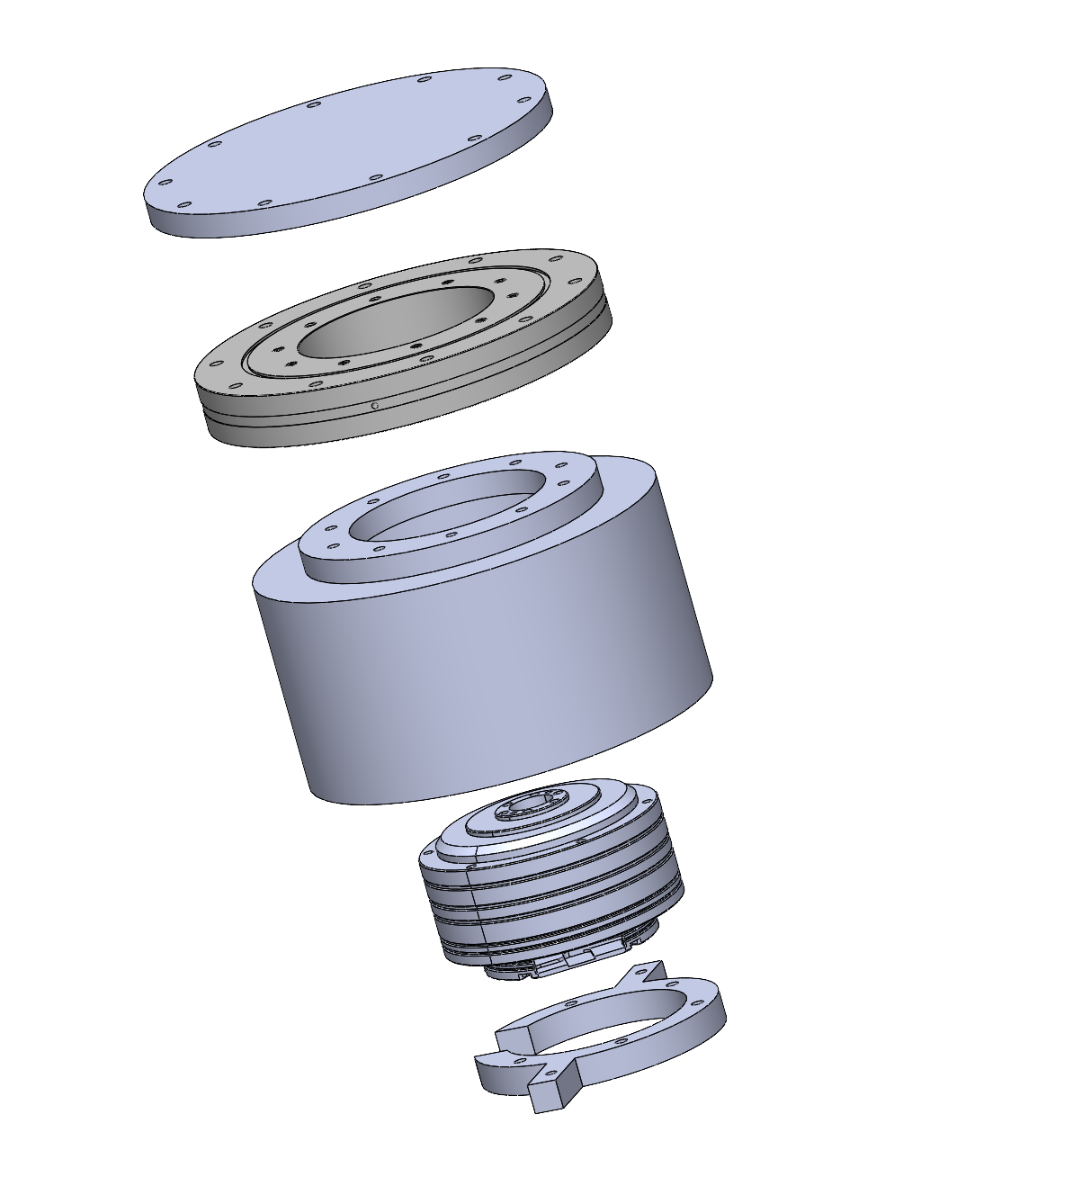
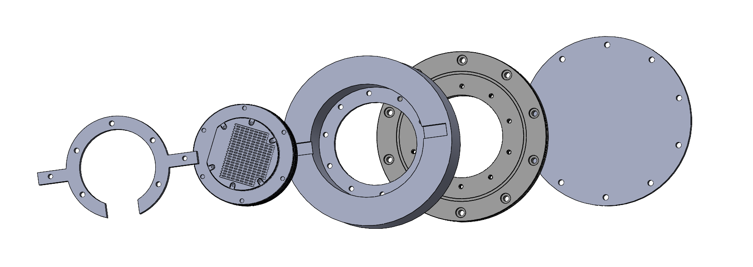
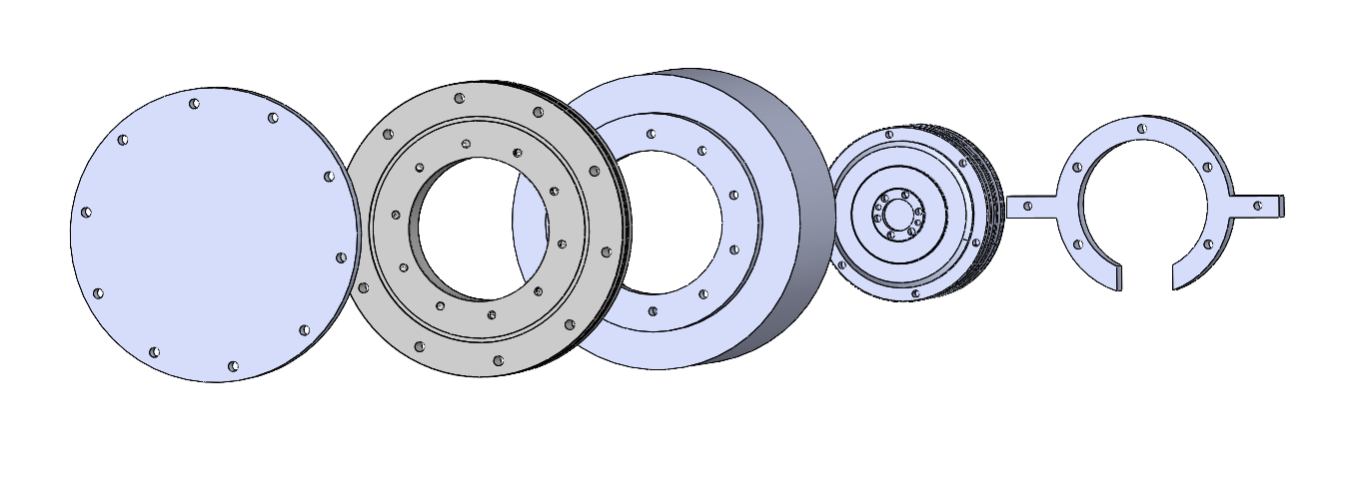
Embodiment Design- J1

Slide 9
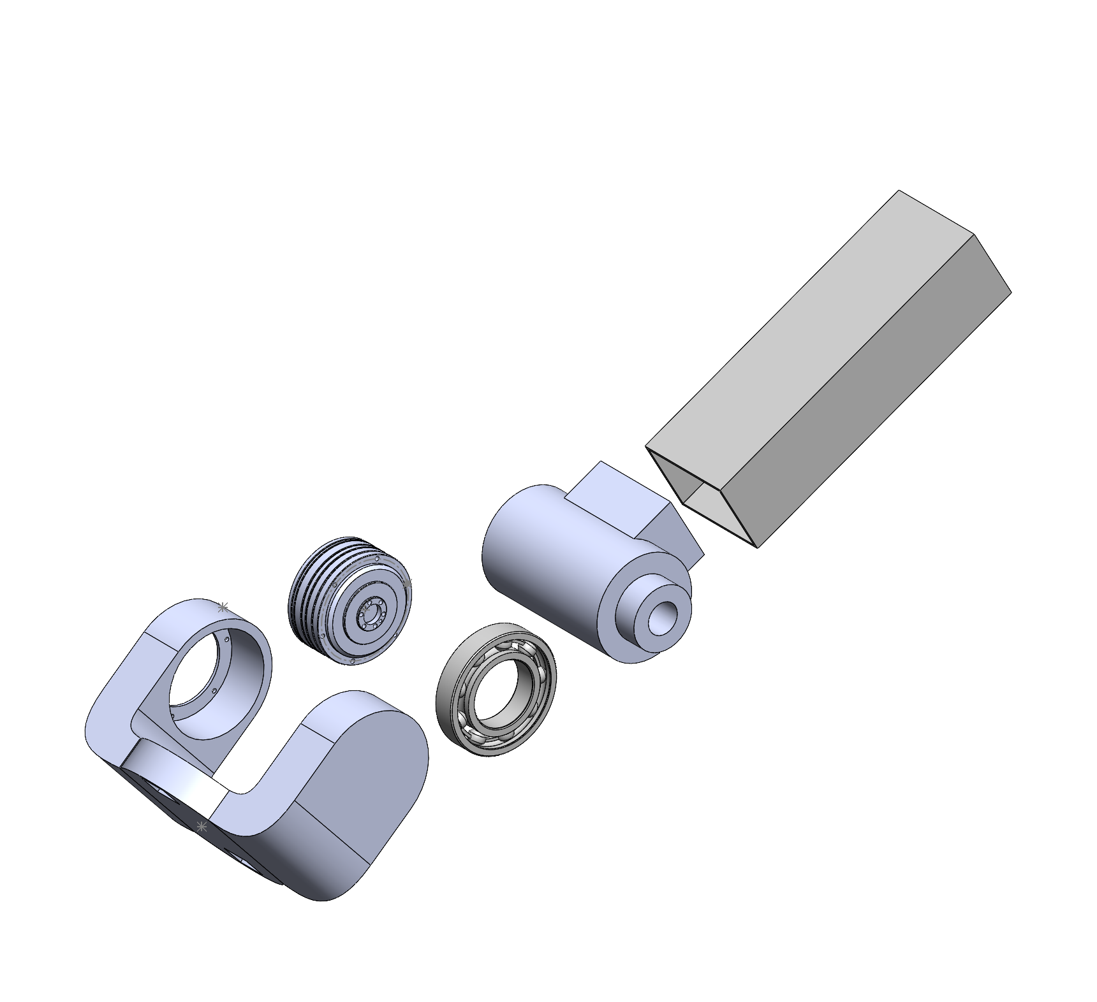
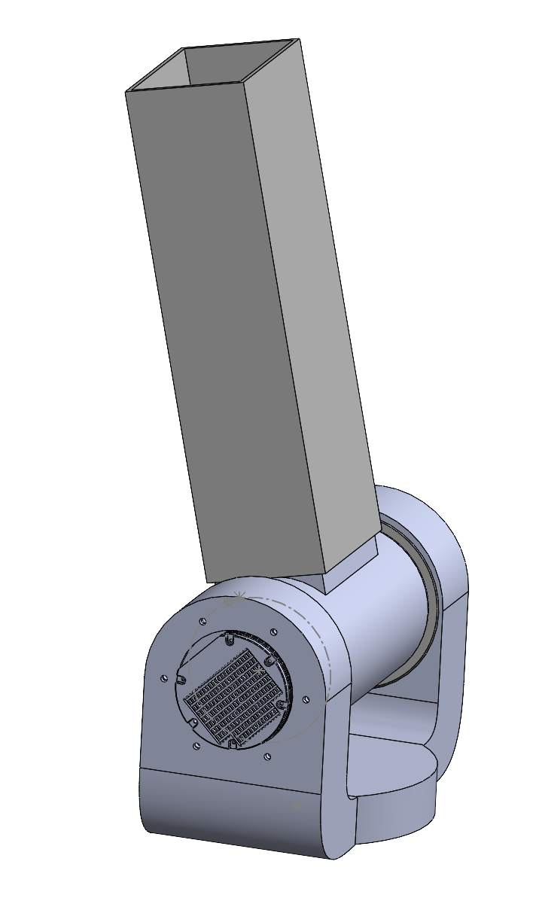
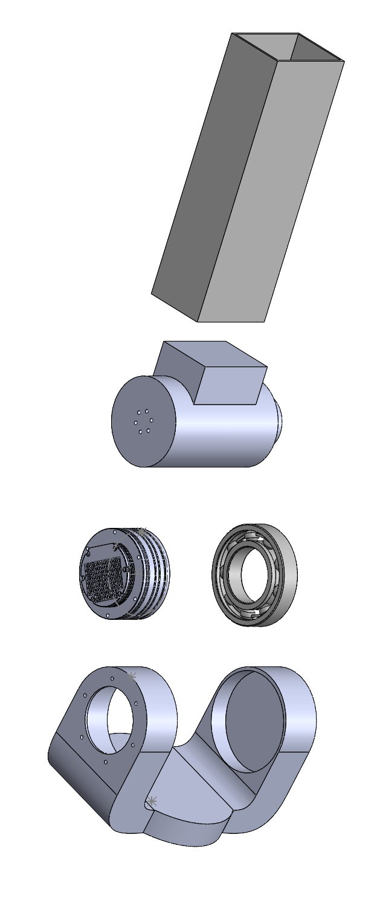
Embodiment Design-J2

Slide 10
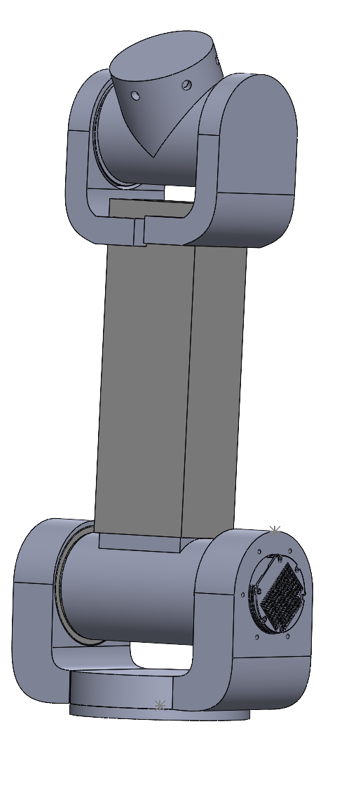
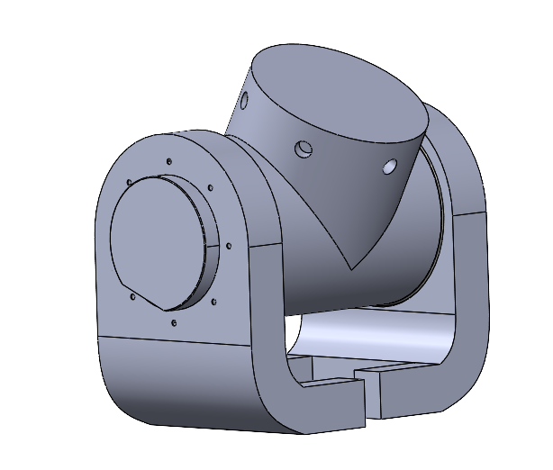
Embodiment Design-J3

Slide 11
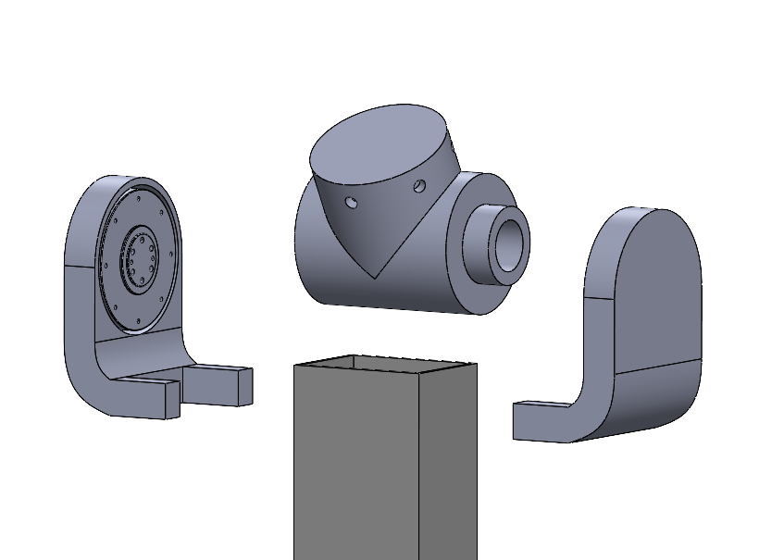
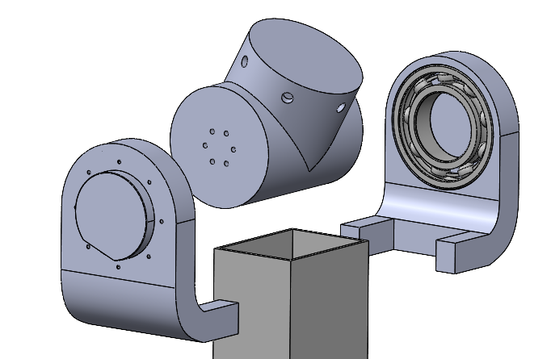
Embodiment Design-J3

Slide 12
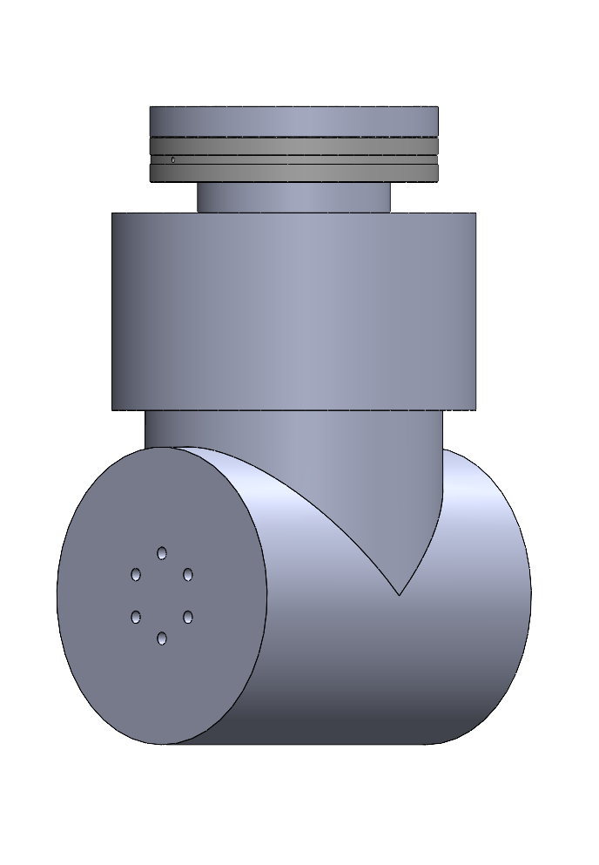
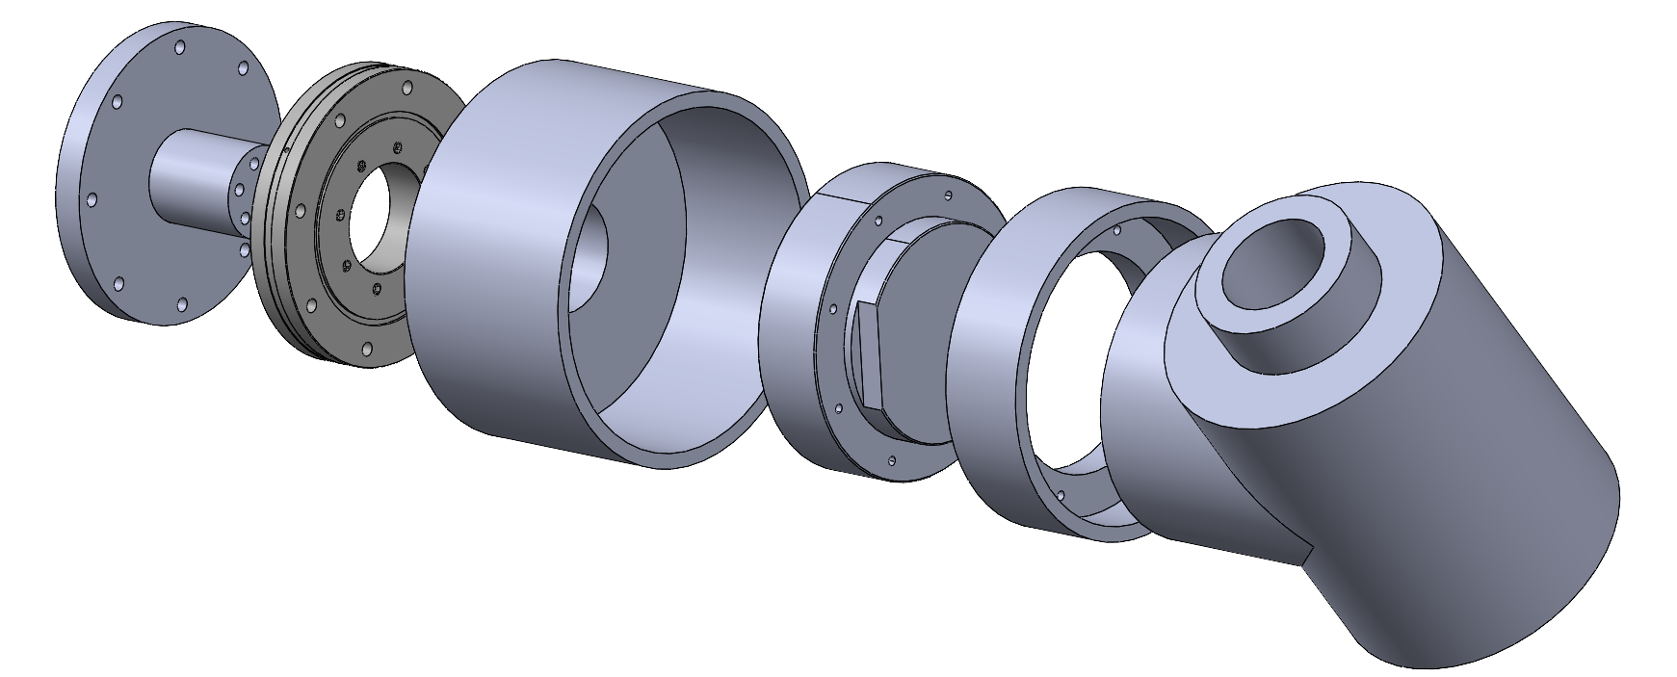
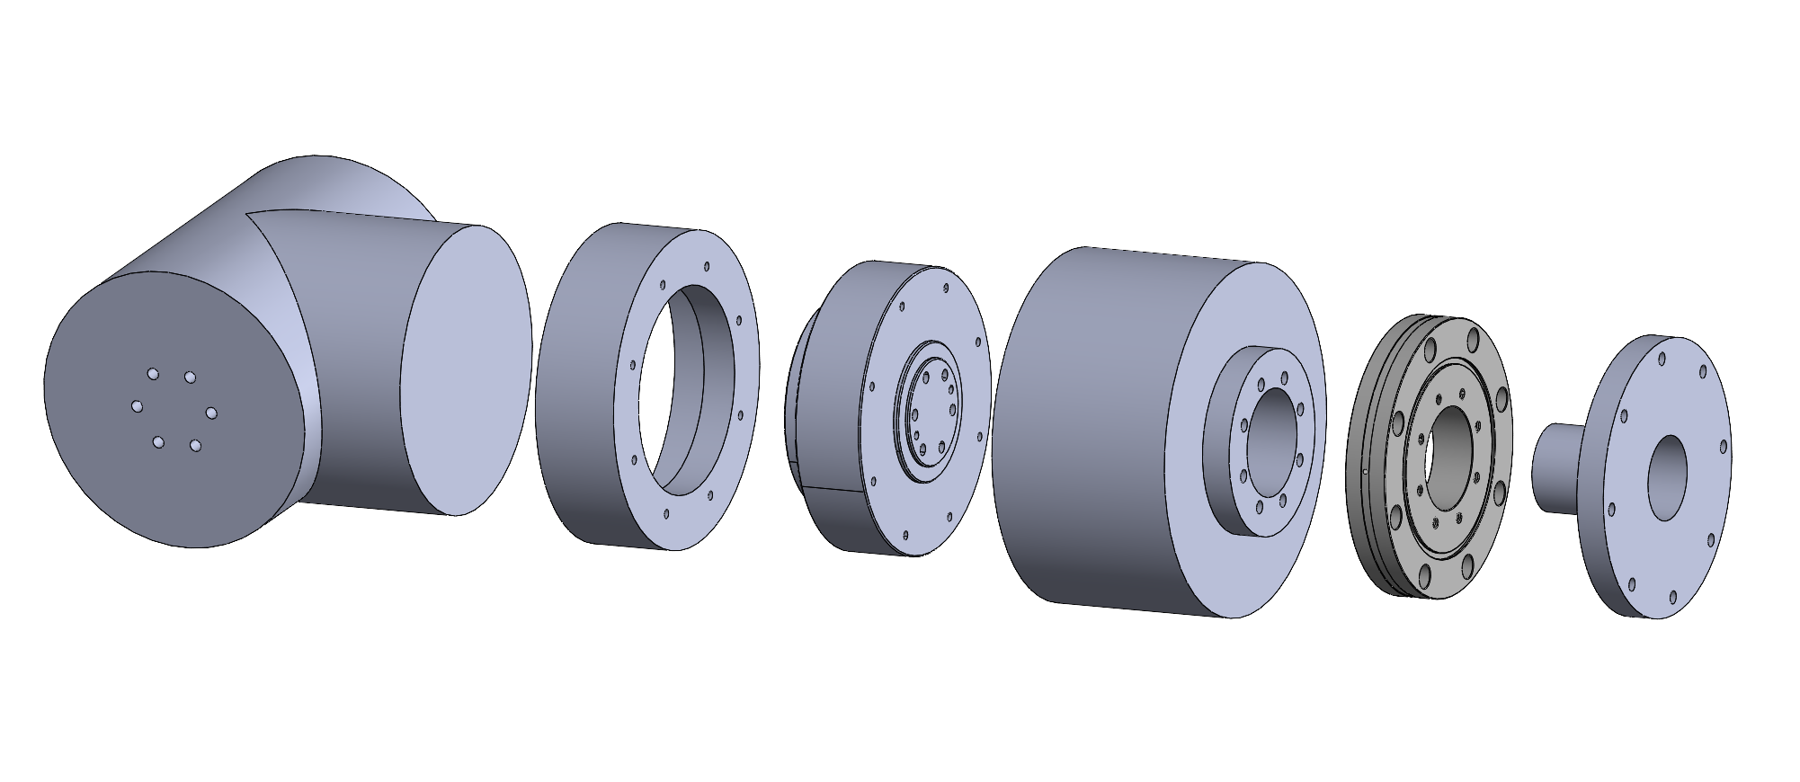
Embodiment Design-J4

Slide 13
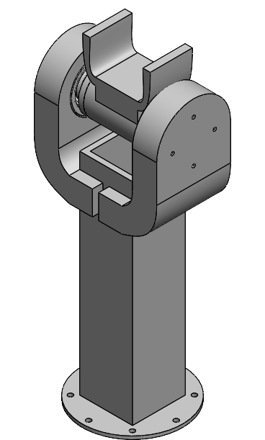
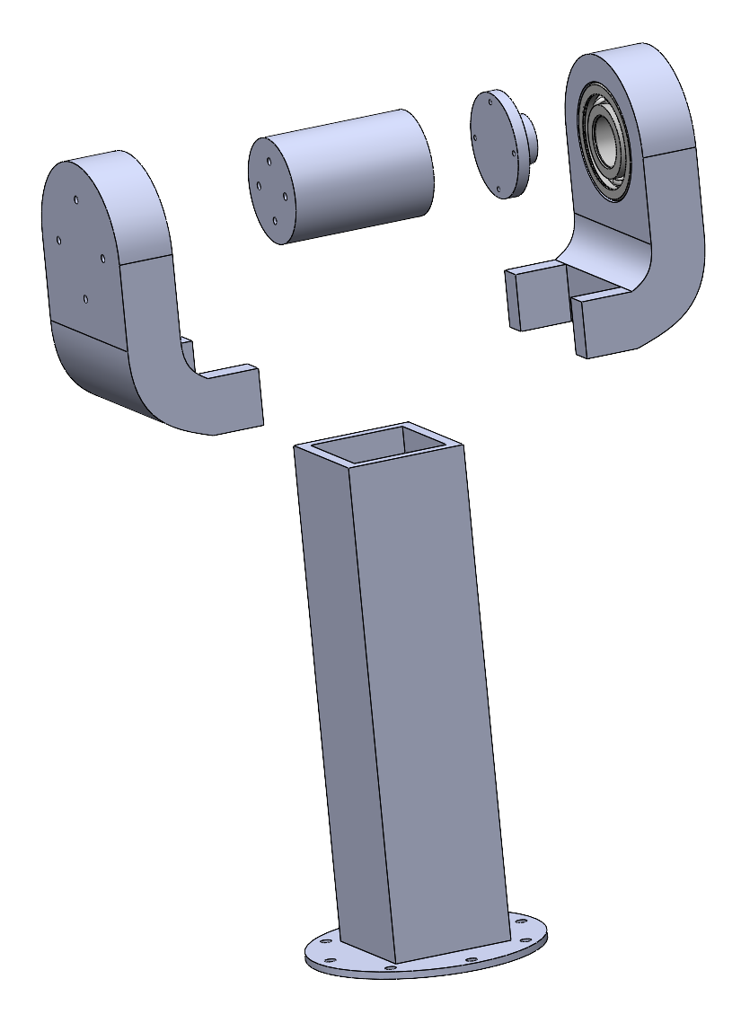
Embodiment Design-J5

Slide 14
Validation Plan for MEEN 402
Finite Element Analysis to ensure that the robot will not break
Inspect all joints to ensure they are free from any obstructing components
Implement initial codes for small translational/rotational movements to validate the motor inputs correspond with the output performance
Validate each motor one at a time before trying to perform movements with multiple movements at once

Slide 15
Final Deliverables
Create a functional prototype that demonstrates the key features
Undergo optimization tests, including mechanical testing and efficiency analysis
Documented in a report, allowing the team to present the results to the sponsor or future project teams

Slide 16
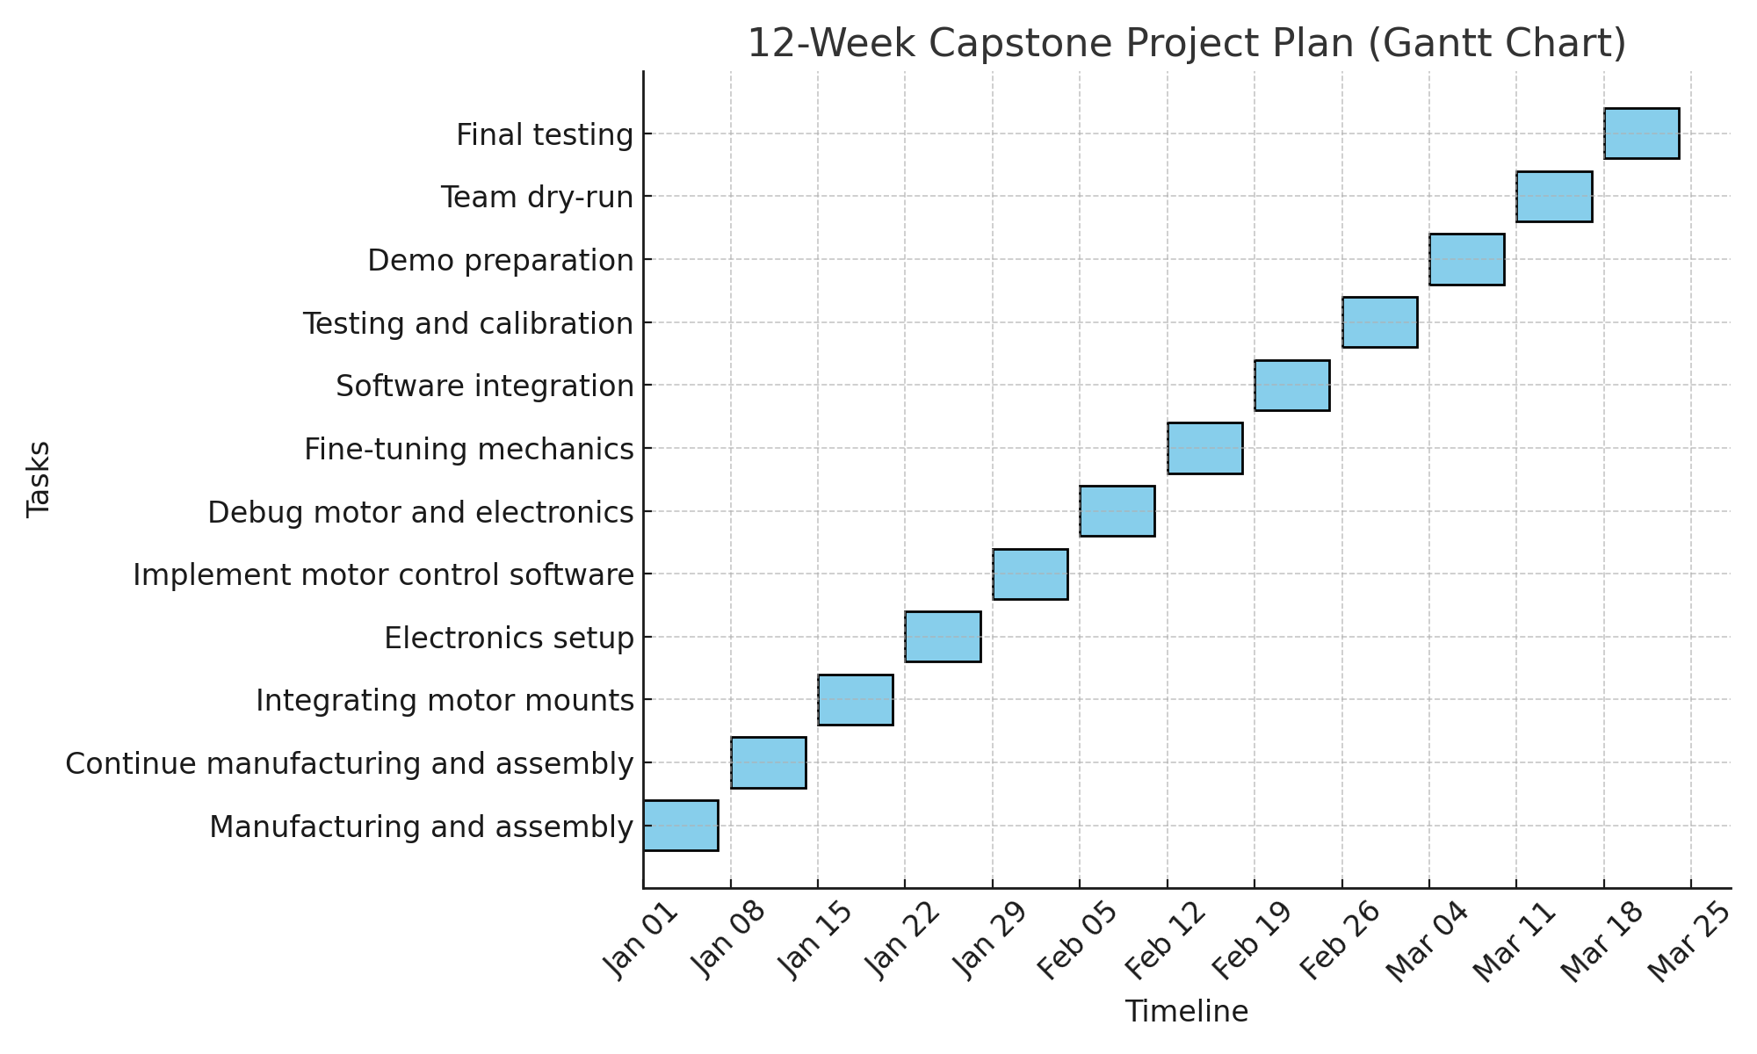
Gantt Chart

Slide 17
401 Final Presentation Discussion
Create a detailed safety document covering all essential protocols
Design and build a safety cage to ensure safe testing conditions
Incorporate a kill switch into the design for emergency shutdowns

Slide 18
Preliminary Product Risk Analysis
Part and Function | Potential Failure Mode | Potential Effects of Failure | Severity | Potential Causes and Mechanism of Failure | Occurrence | Current Design Control Test | Detection | Recommended Action | RPN
Actuators (Joint Motors) | Failure to move or incorrect movement | Inability to position the arm correctly, leading to task failure or collision | 9 | Motor wear, overload, overheating, power supply issue, seizing | 4 | Periodic motor inspection | 3 | Upgrade motor rating, add overload protection | 108
Control System (Software) | Failure in control algorithm | Inaccurate control, potential for oscillations, lack of stability | 8 | Software bug, incorrect control tuning, signal noise | 2 | Code reviews, simulation testing | 3 | Improve controller tuning, add redundancy checks | 48
Arm Structure (Links) | Structural failure or deformation | Misalignment in movements, excessive vibration | 10 | Material fatigue, impact load, stress concentration | 2 | Stress analysis during design, load testing | 2 | Use stronger materials, inspect regularly | 40
Encoders (Position Feedback) | Loss of position feedback | Loss of position control, leading to inaccurate movements and potential collisions | 8 | Sensor failure, electrical noise, misalignment | 3 | Regular calibration, signal filtering | 3 | Use higher-quality encoders, improve shielding | 72
Joint Motors | Overuse/Burnout | Motor overheating, reduced lifespan, loss of functionality | 8 | Continuous use, Continuous high load operation, Lack of Cooling | 6 | Thermal sensor monitoring, maintenance checks | 3 | Implement time usage limits and torque limits. | 144
Electrical Failure | Failure to power motors | Loss of movement in the arm, burning out motor | 9 | improper wiring, wrong power source, over use of motors | 3 | checking each individual motor, voltage testing across wires | 3 | Implement wire testing, implement safety on voltage | 81
Structural Components | Fastener Loosening/Thread Stripping | Components loosening/falling out of place/robot becoming unstabilized | 8 | Excessive vibration/parts not moving cohesively together/moving against each other | 5 | Testing each motor individually/confirming all connectors are secure with proper inserts | 2 | Ensure that each insert is of proper size and screws are rated for high vibrations | 80

Slide 19
Future Work
Order all materials and parts for prototyping
Research and evaluate circuit designs/electronics/power supply
Learn and experiment with motor functionality
Write test python scripts for motor maneuverability
Adding Fasteners to the CAD Design
Conducting FEA on Critical Components of Robot

